Slide 1

[DRAFT DOCUMENT]
AFL VIC – PlayHQ Training
Club Session 3 – Club Set Up
August 2021

Slide 2
Training Agenda
PlayHQ test site information
PlayHQ admin portal
PlayHq participant portal
Season set up for clubs
Notes:
This session is to assist with the first steps of getting to know PlayHQ and to assist in the initial set up. This is to be used in conjunction with the Club Manual and all the resources available on AFL Clubhelp. Not all functions have been released at the time this was created but all function availability and release dates can be found on the League Go To Market pack.

Slide 3
Test Site Information
Test Environment Access
Test login details as either a League or Club Admin are below-
League Admin Login Club Admin Login
E – playhqleague@gmail.com E – playhqclub@gmail.com
P – PlayHQ2021! P – PlayHQ2021!
UAT Participant site: https://www.uat.playhq.com/
This is the test site which replicates the Participant Portal. Any information on this site is not available to the general public and links should not be shared with anyone who does not have admin access. On this site you can view fixtures, ladders and results, as well as registration forms.
UAT Admin site: https://afl.uat.playhq.com/
On this site you can manage mirror competitions, enter results, create new competitions and registration forms. You are also able to add merchandise, set up program registrations and explore the reporting functionality.
UAT Electronic scoring site: https://afl.score.uat.playhq.com/
This site is used for electronic scoring. Games which have been fixtured and allocated to a venue can be downloaded and scored electronically.
Notes:
They will be able to access this test platform to try out before they set up their club in the live environment.

Slide 4
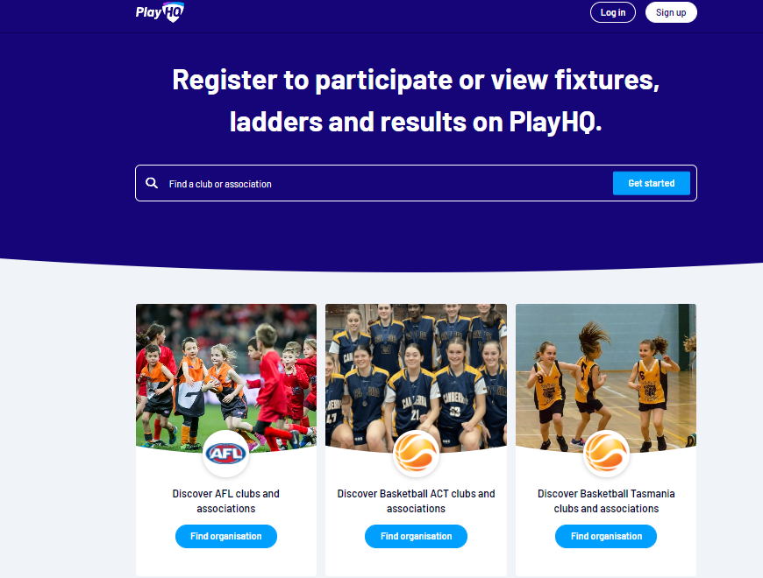
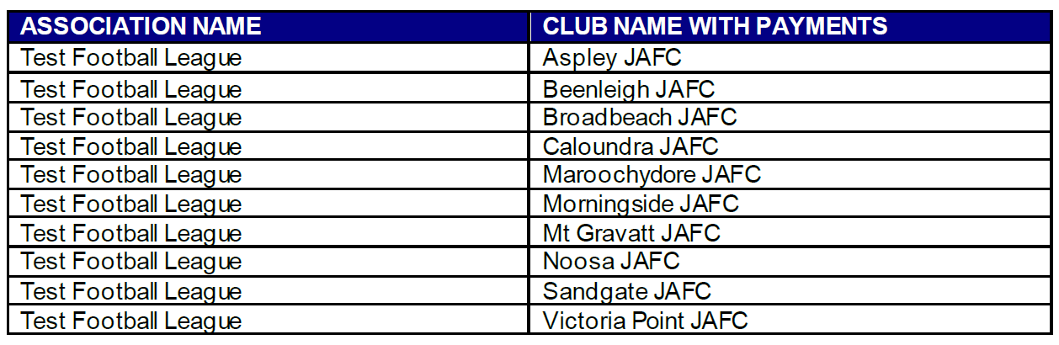
Test Platform
To assist your familiarisation with PlayHQ, a sample Competition Grade has been set up along with the relevant Clubs. This will enable you to enter results each week, view ladder updates, use the electronic scoring functionality and test out features related to the weekly running of competitions.
This will allow you to enter fees when setting up sample registration forms or creating merchandise products. If you are attempting to complete a registration which requires payment you can use the below dummy Credit Card details:
CC: 4242 4242 4242 4242
Expiry date: 02/24 CCV: 222
Payments have been activated at the below Association & Clubs name.
Notes:
They can use the test participant platform to register themselves and try out from a participant point of view.

Slide 5
Admin Portal
To login and access any database go to https://afl.playhq.com/ and enter the username & password you have registered.
Notes:
You will be sent an invite when you have been added to your admin portal. Then you will be able to either set up your PlayHQ account or log in if you already have one. Some sports have already been using PlayHQ and thus some people might already have an account which they can use to log in.

Slide 6
Using As
When you have logged in you see the name of the organisation you are Using as in the top left corner. If you are an admin for more than one organisation you can click in the Using as area and it show you a list of the organisation you have access to.
Notes:
To find your club you have to use the “using as” section on the top left corner. You can access your clubs by typing in the name. All the clubs/organisations you have access to you will be able to find here.

Slide 7
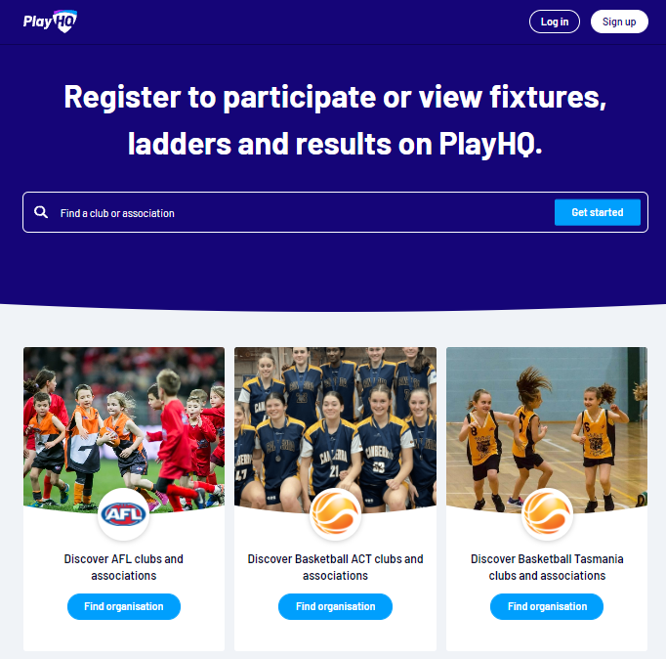
Participant Portal
There are multiple options for Participants to find the club registration form and begin to register.
Option 1 is to go to https://play.afl/ and use the locator to find the Club they wish to register with and the link to register with the Club.
Option 2 is go to https://www.playhq.com/afl and the search function to find the Club they wish to register with and the link to register with the Club.
Option 3 is for the Club to provide the Participant with the unique URL for the club registration form.
Click on the Get started button.
Notes:
This is what the participants use to find their league or club and register. They can log into their account here and look up their own profile and check their history and check match details, ladders and statistics. If your profile is public you will be seen here if others look you up too-Not your personal/private details. Team managers with admin access log in via this website too to perform their manager duties such as line ups. More on that later on.

Slide 8
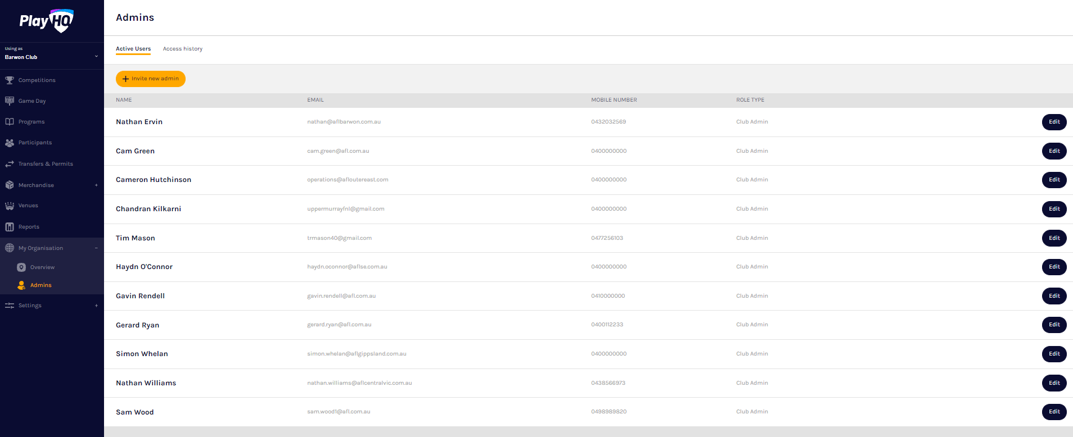
My Organisation – Adding Admins
In the left-hand menu click on My Organisation then select Admins
In the Active Users tab click on the Invite new admin button.
Add the administrator’s details and click on the Invite Admin button in the top right corner.
The administrator will be added and you will return to the Active Users list with confirmation message.
The administrator will receive an email from PlayHQ inviting them to either create an account or login to the platform.
To remove an administrator in the Active Users list click on the Edit button for the user you want to remove and click on the Revoke User button.
Notes:
Admins in PlayHQ formerly known as Users in the GameDay (SportsTG) system. Admin Body in PlayHQ formerly known as State or Region in the GameDay (SportsTG) system. Admin Portal in PlayHQ formerly known as Database in the GameDay (SportsTG) system

Slide 9
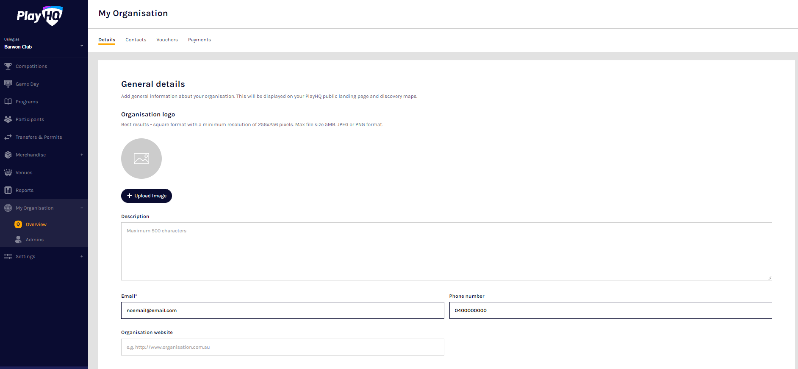
My Organisation - Details
In the left-hand column go to My Organisation then select Overview.
Click on the Details tab.
Add your club’s details.
Add your club T&C’s. If you would like to add your own.
Click on the Update & Save at the bottom of the page.
Please note this information is important as it appears on your Club’s PlayHQ registration page.

Slide 10
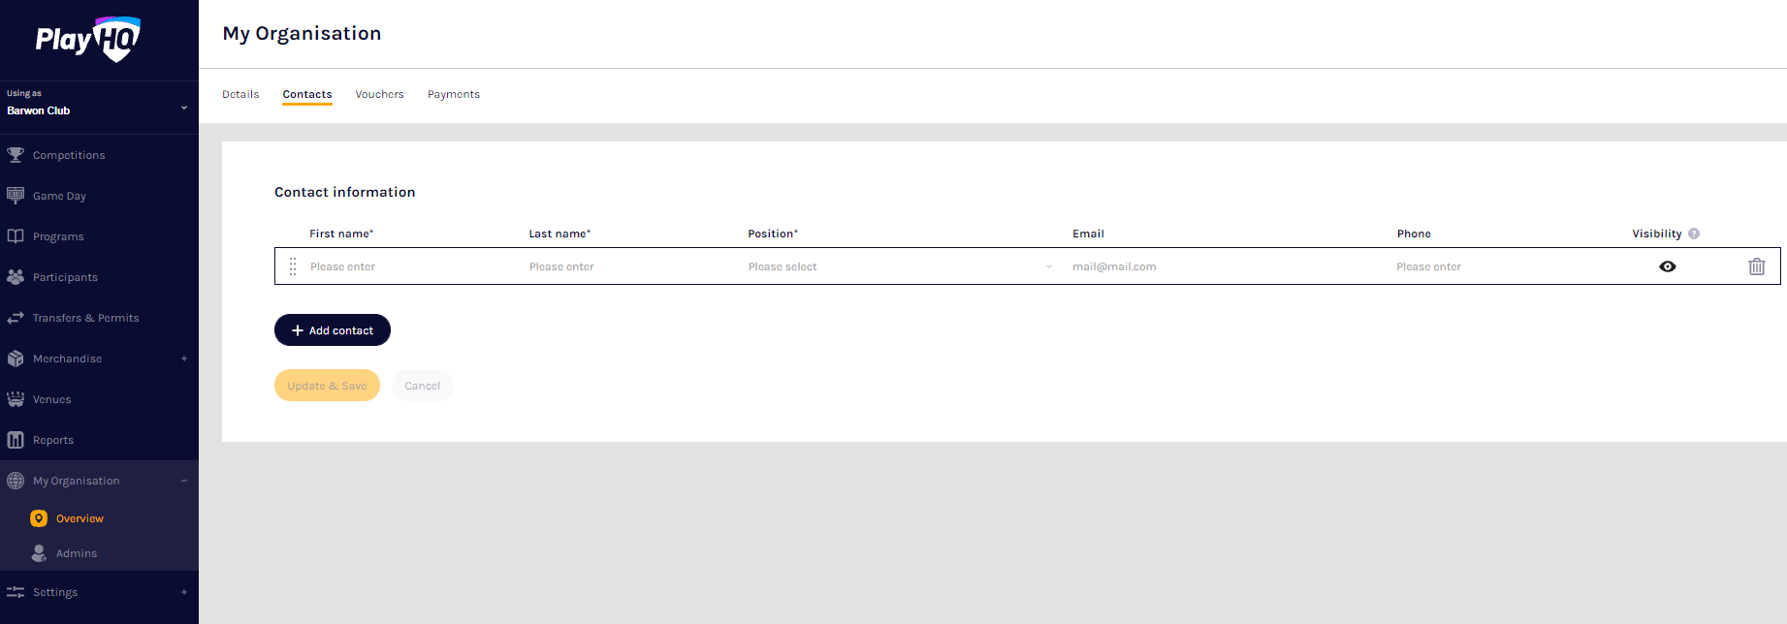
My Organisation - Contacts
Click on the Contacts tab.
Add one or more contact for your club, it is mandatory to First Name, Last Name & Position.
Click on the Update & Save button at the bottom of the page.
Please note this information is important as it appears on your club’s PlayHQ registration page.

Slide 11
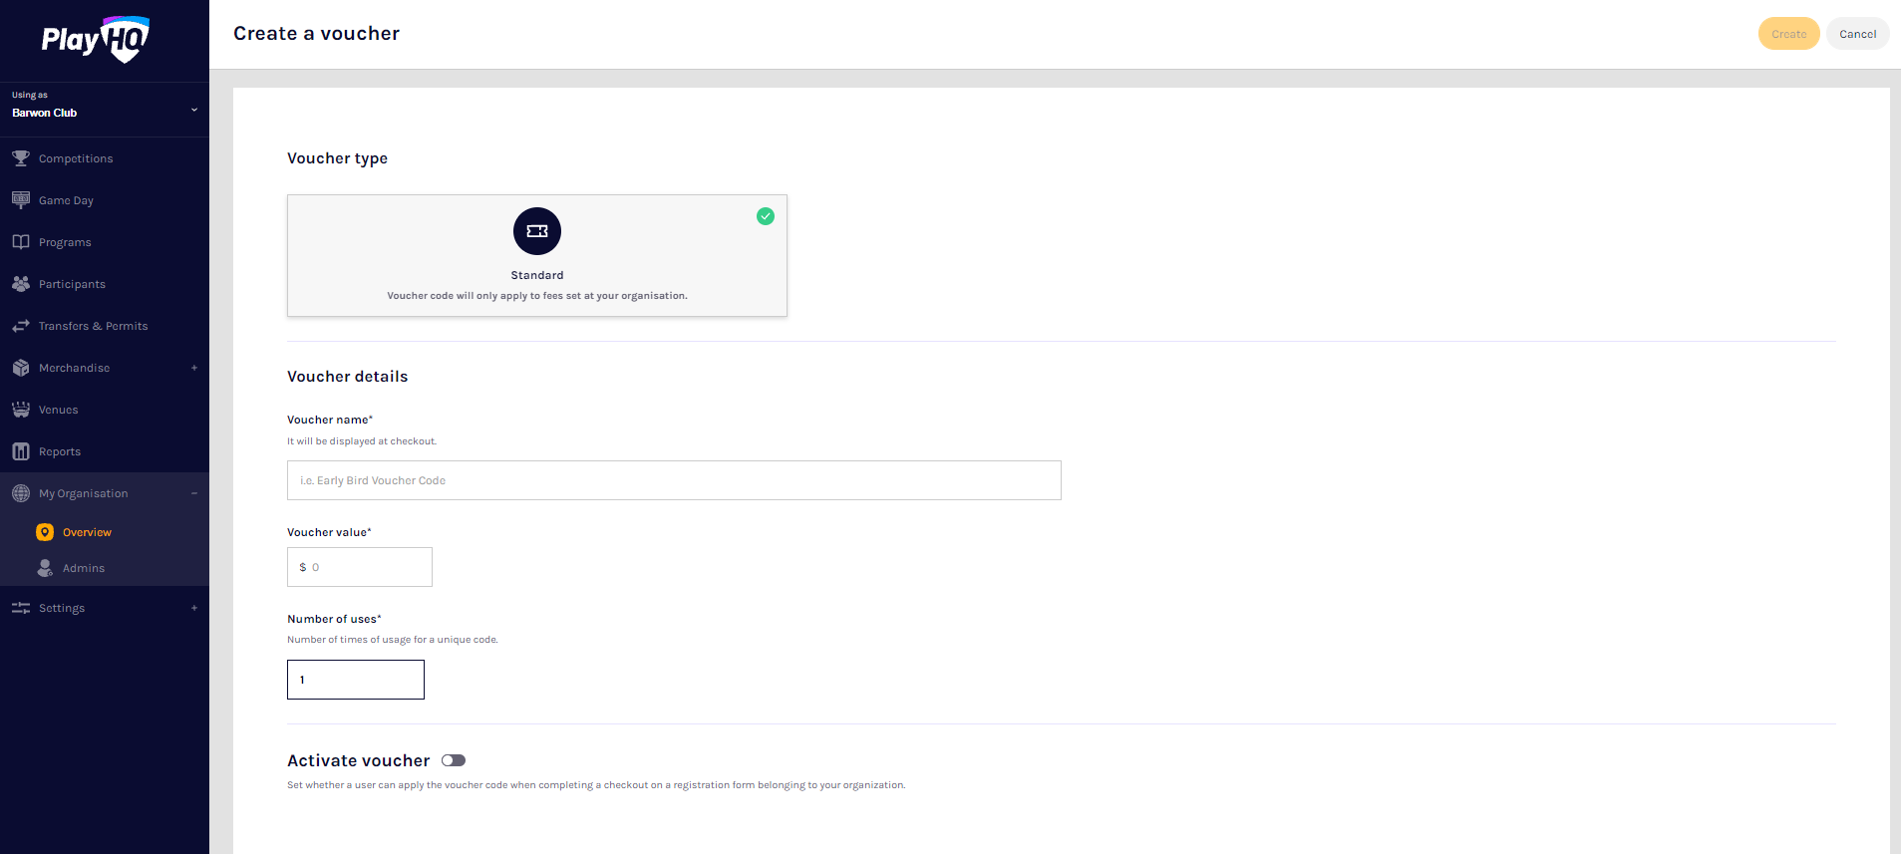
My Organisation - Vouchers
Vouchers are an exciting new feature in the PlayHQ platform which enable Community Football Associations and Clubs to provide a discount to their organisation registration fees at the payment stage of the registration process.
Click on the Vouchers tab. If you wish to add a Voucher click on Create a Voucher, complete the required fields, set Voucher can be applied at checkout to On and click on the Create button in the top right corner.
You can create individual vouchers or set a limit of up to 10000 per voucher.
De-activate voucher when you no longer need this.
Vouchers only discount the fees at the level it was created.
Notes:
If a voucher is created at league level this will then only apply the discount to the league fees. If created at club level it will only discount the club fees.

Slide 12
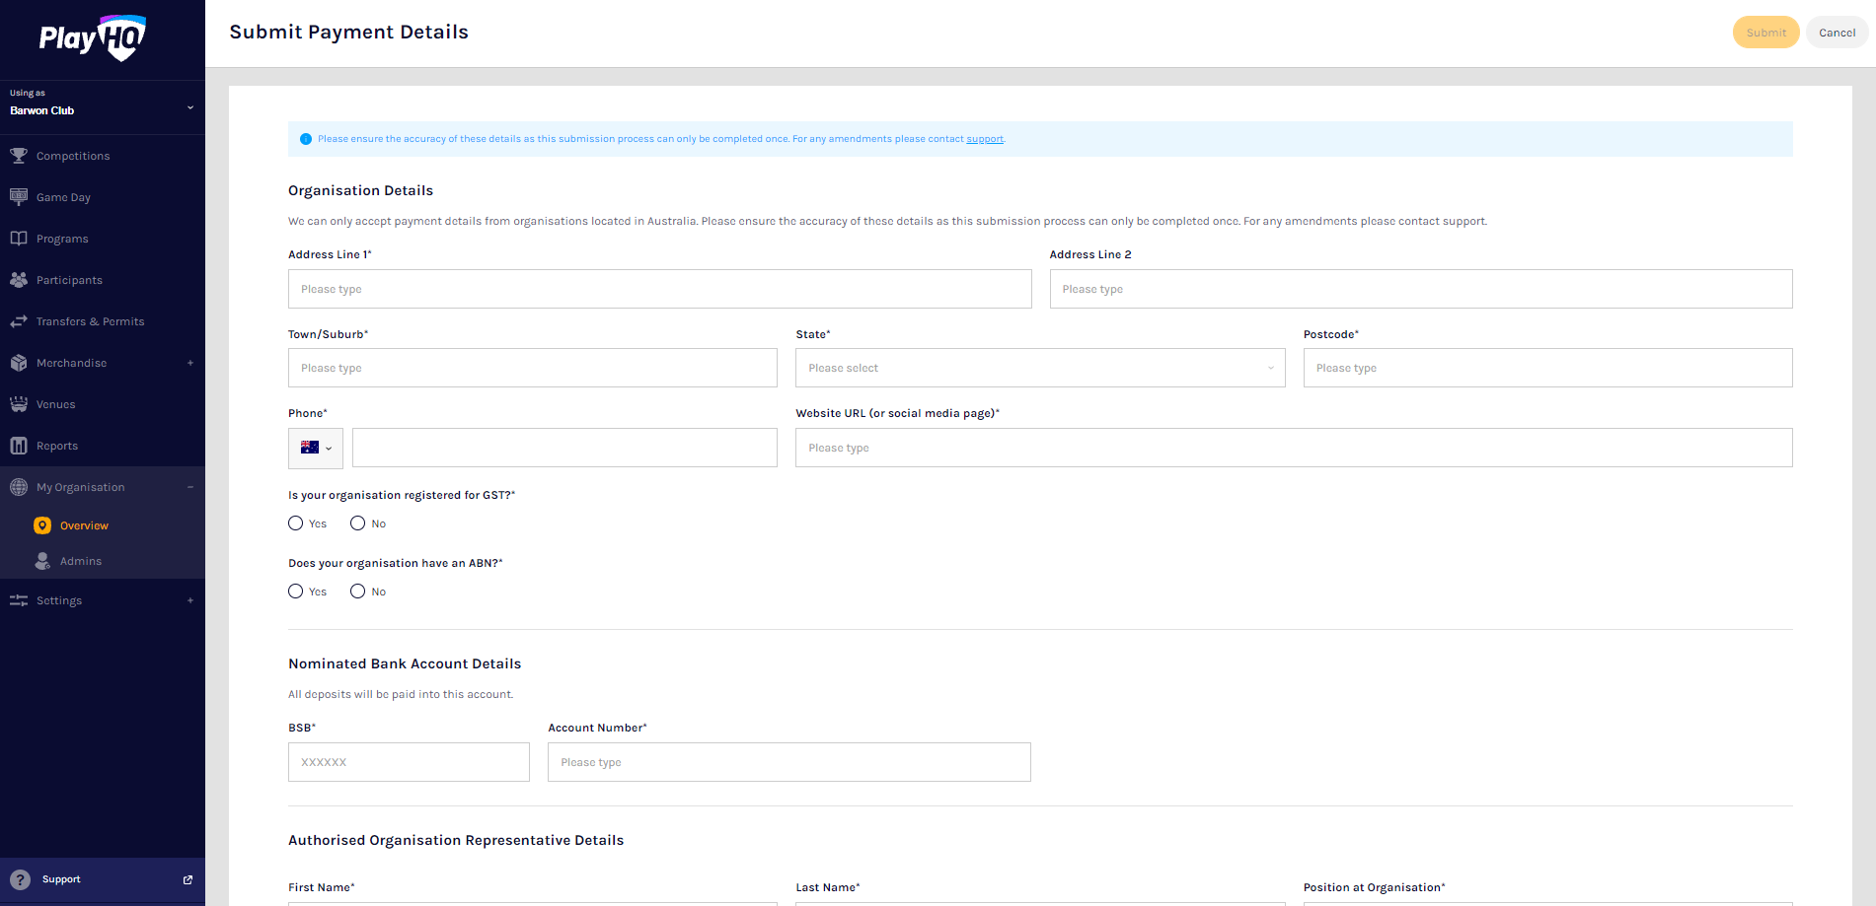
My Organisation - Payments
Please note all organisations that wish to accept online payments must complete this function. Bank details added in the previous platform will NOT be transferred in the PlayHQ platform.
Click on the Payments tab, click on the Submit Payment Details button and complete the required fields.
Add Organisation details and select answers to GST questions.
Add Organisation bank details and representative details.
Select Photo Identification method, either Drivers License OR Passport and upload image(s), agree to the Terms and Conditions, and click on the Submit button at the top of the page.

Slide 13
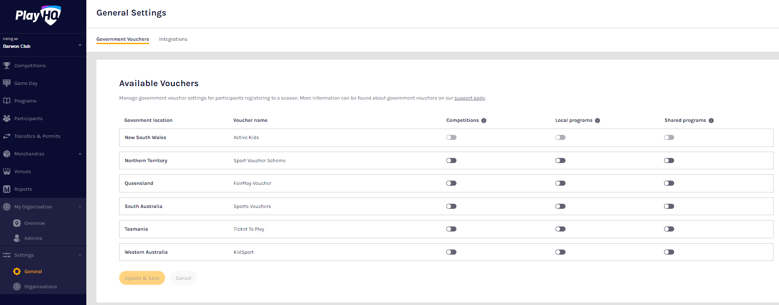
Settings- Government vouchers
If your organisation is registered with your state government voucher program you can turn on the button in the Competitions column and click on the Update & Save button.
Please note you can turn on more than one state for those organisations that cross a state border.

Slide 14
Settings- Integrations
As part of your Club Administration duties you may need or want to email your participants to provide general information, and ad hoc communication and updates. Using PlayHQ and another platform called Mailchimp, you can easily and quickly integrate / automatically feed your participants email addresses into Mailchimp and send emails.
Mailchimp is a free online tool that you can use to send emails to your participants. You can integrate to add existing Mailchimp account or create a new Mailchimp account.
To create a new Mailchimp account go to https://login.mailchimp.com/signup/. Enter your email address, and nominate a username and password. Click Sign Up.

Slide 15
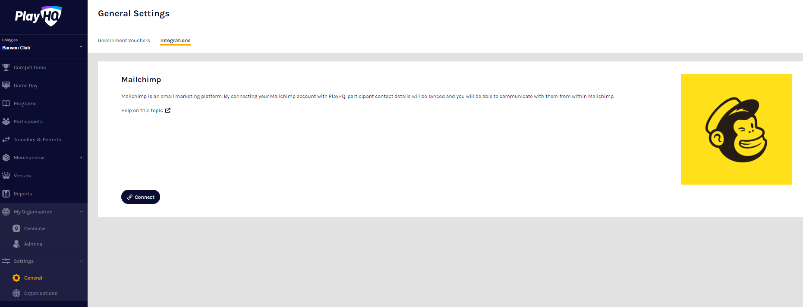
Settings- Integrations
To connect a Club to a Mailchimp account, in the left hand menu select Settings, select General, click on the Integrations tab and click on the Connect button.
On the Connect Mailchimp page click on the Log in to Mailchimp button.
On the Log in and authorize page enter the Username and Password of the Mailchimp account you wish to connect to and click on the Log In button.
On the Authorize PlayHQ PoC page click on the Allow button.

Slide 16
Integrations - Sync Mailchimp
You will return to PlayHQ Connect Mailchimp page, in the Audience area select a Primary Audience and click on the Save & Connect button in the top right corner.
The page will update with a confirmation message. When the connection is created to Mailchimp, PlayHQ will immediately start synchronising your organisation's contacts.
When the synchronising is complete the Sync Status will change.
Daily synchronising of your organisation's contact will occur overnight.
Notes:
More information about integrations will be in a separate session..

Slide 17
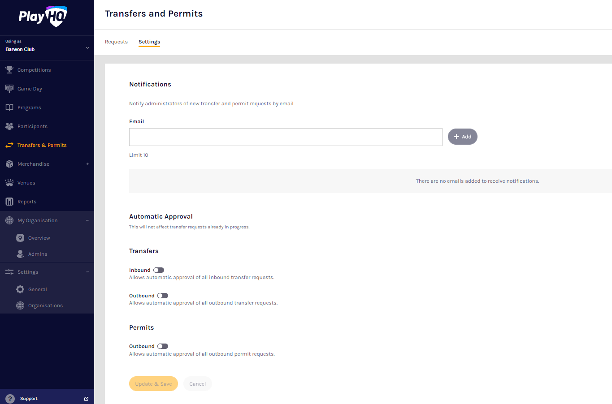
Transfers & Permits - Settings & Add notification emails
In the left-hand column select Transfers & Permits and then click on the Settings tab.
In the Notifications section you can add up to 10 Email contacts to receive transfer notifications via email.
In the Automatic Approval section you can turn on automatic approval for all Inbound and/or Outboard and/or Internal Transfers and Internal Permits.
Click on the Update & Save button.

Slide 18
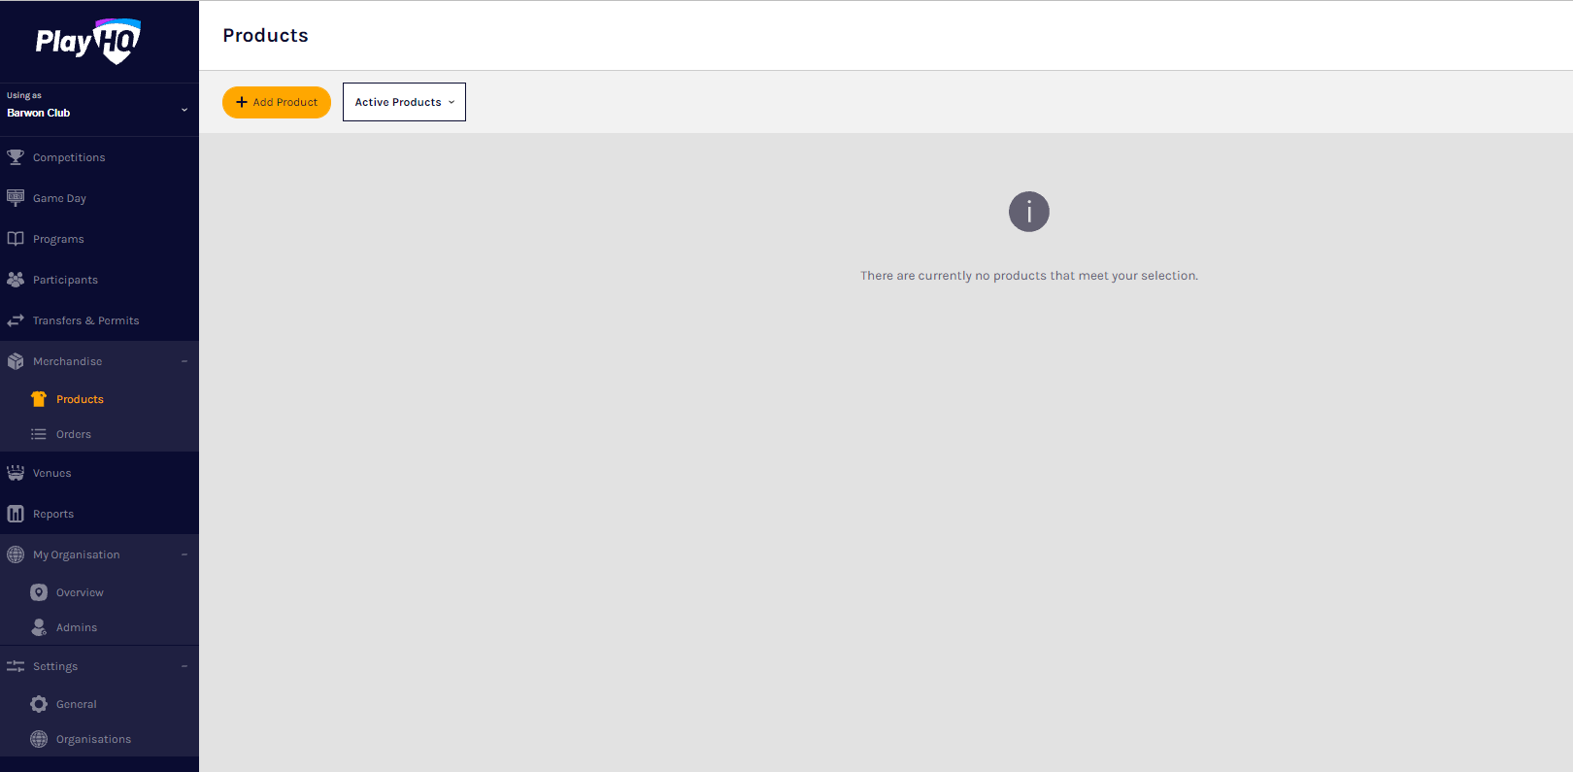
Merchandise - Products
This section is optional and is only required to be completed if your centre wishes to sell merchandise.
In the left-hand column go to Merchandise, select Products and click on the Add Product button.
On the Add Product page add the Product Name and Description. Turn Product Active on or off, the default would be on but if the product becomes unavailable change to off.
Upload an Image of the product if you have one (not mandatory), up to 10 images can be uploaded.
Select Product Single and add one value for the product.
Or select Product Variations and add the variations with their value.
Select Fulfilment Method – Pickup or Delivery – if Delivery is selected it will prompt the customer to add a shipping address in the registration process.
Click the Save button at the top of the Create a new product page.

Slide 19
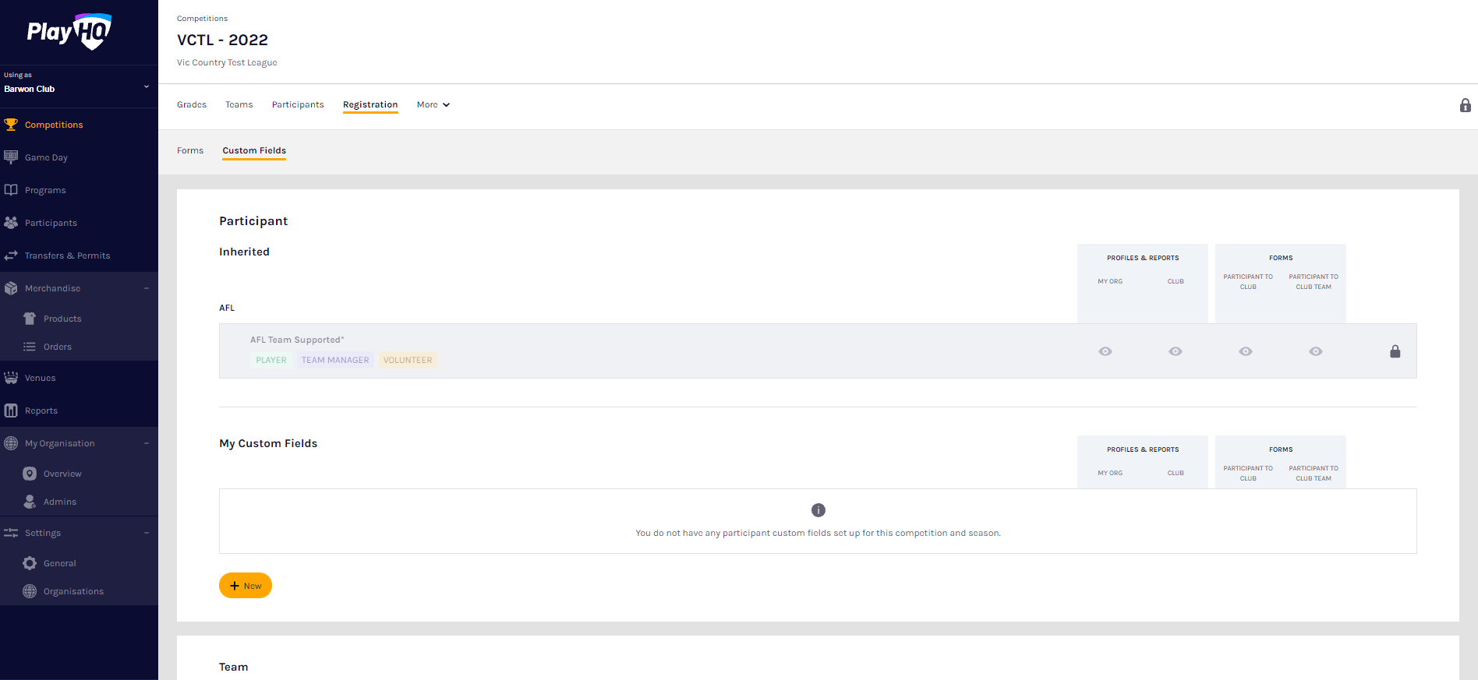
Registrations - Custom fields
In the left hand menu click on Competitions. In the My Competitions tab click on the View button
Click on the Registration tab and the select Custom Fields tab.
Any Custom Fields created at national, state, region or association levels will be shown and locked.
The Club can create any Custom Fields they may require by clicking on the New button in the My Custom Fields area.
On the New Custom Field page in the Details section enter the Field Label and select the Type.
If the Type is Dropdown List enter the options in the Dropdown Options. If you need more than two options click on the Add Option button.
In the Display Configuration section select the Roles the Custom Field will appear for, tick the required boxes in the Settings area and click on the Create button in the top right corner.
You will be returned to the Custom Fields list with a confirmation message.

Slide 20
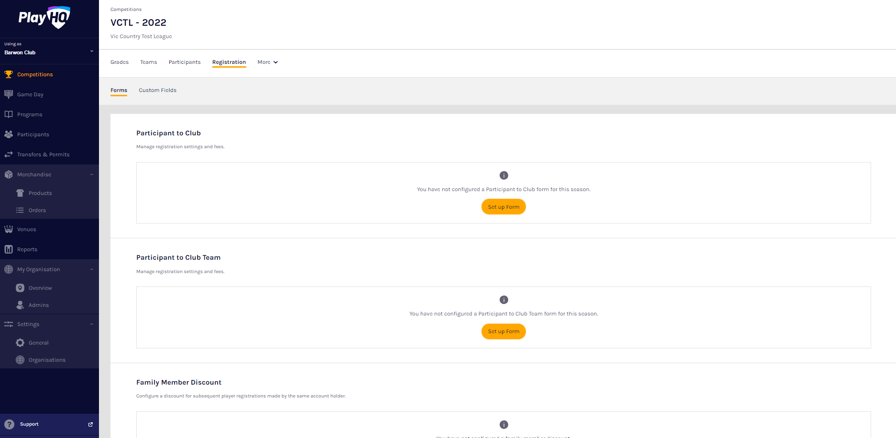
Registrations
Configure - Participant to Club form
Click on the Registration tab and the select Forms tab. In the Participant to Club area click on the Set up Form button.
In the Registration Period section add the Start date & End date for the club to accept participant registrations.
In the Age limit section you will see any age restrictions that have been created.
In the Registration fees section you may see a fee that has been set at the national, state, region or association level and passed down, these fees cannot be removed or edited.
In the Set Player, Team Manager and Volunteer fee area you can add a Club fee by adding an amount in each of the Roles. If you have different fees for different age groups and/or genders you can use the Set advanced registration fees area.
In the Custom Fields section you will see any Custom Fields that have been created all levels.
In the Products section any Products created by the Club can be added.

Slide 21
Registration
Form Overview
In the Overview section add information in Pricing information and Additional information areas.
If the club added Terms and conditions in the My Organisation – Overview – Details section they can be turned on to be added to registration form.
In the Registration visibility section select either Visible or Hidden. This will determine whether the Club registration form is visible by the public. The Club may elect to hide the registration form but use the link to the form to send out to their participants as a way of restricting registrations.
Click on the Save button in the top right hand corner.
The Club registration form will be created, you will be taken back to the Forms page with a confirmation message that the Club registration form has been created.
To make changes to the registration form settings you can click on the Manage button.
Notes:
Keep hidden until 01/11/21- or chosen date after 01/11/21.

Slide 22
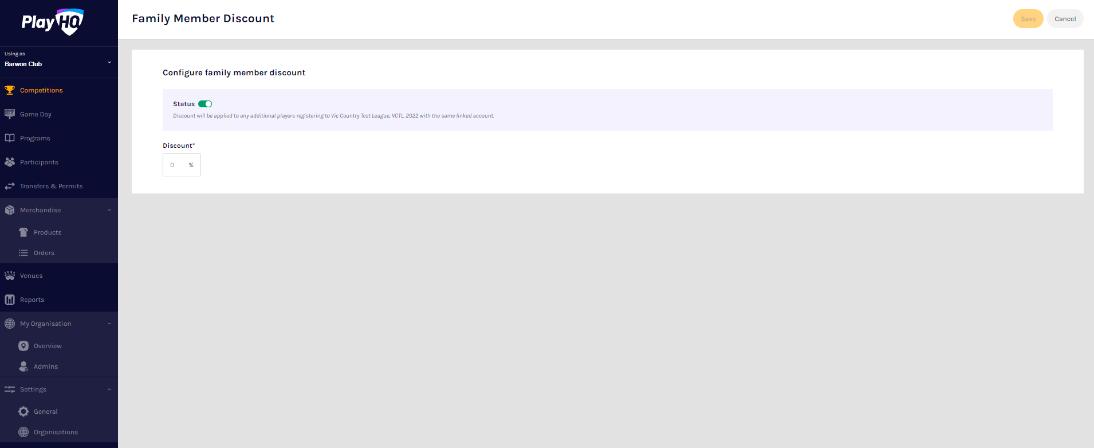
Family Discounts
Click on the Registration tab and the select Forms tab. Scroll to the bottom of the page and in the Family Member Discount area click on the Set up Discount button.
Turn the Status button on, add a percentage amount in the Discount area and click on the Save button in the top right hand corner.
The Family Member Discount will be created, you will be taken back to the Registrations page with a confirmation message that the Family Member Discount is Active.
To make changes to the registration form settings you can click on the Manage button.
Notes:
Fees in PlayHQ formerly known as Products in the GameDay (SportsTG) system.

Slide 23
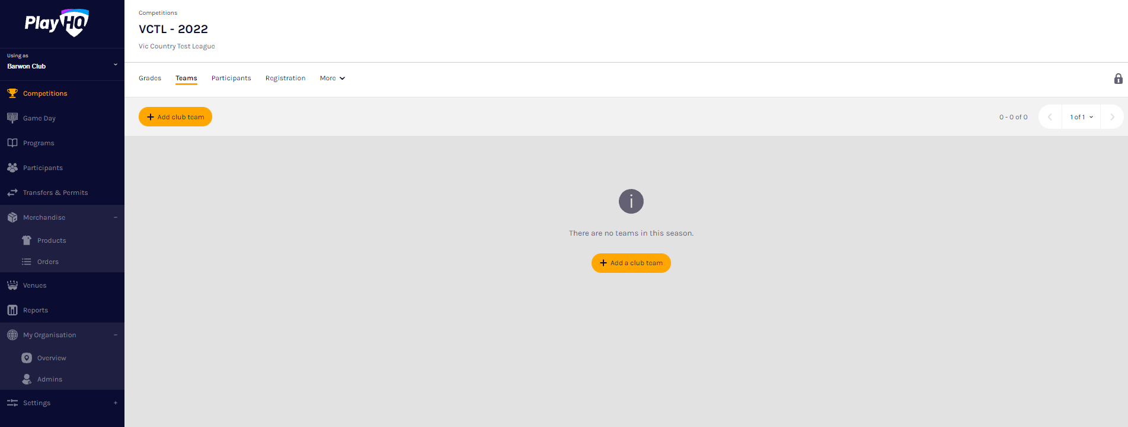
Create Teams
All Teams must be created while Using as the Club level.
In the left hand menu click on Competitions, click on the View button for the Competition, click on the Teams tab and click on the Add club team button.
In the Team Information area as the Age Group, Gender & ID are selected the Team Name will begin to populate which can also be edited.
In the Home Venue area add the Venue & Ground for the team.
Click on the Add team button in the top right corner.
To make changes to the team settings you can click on the View button.
Allocate Teams to Grades
In the left hand menu click on Competitions, click on the View button for the Competition and click on the Grades tab.
The Club Team Allocation period is set by the Association.
If it shown as locked Clubs will not be able to Allocate Teams to Grades, you must change the Using as organisation back to the Association.
Notes:
Grade in PlayHQ formerly known as Competition in the GameDay (SportsTG) system. If it’s locked by the association the padlock in the right corner is closed.

Slide 24
Participant registration - Approval
If New Player Approval has been turned for Clubs by the Association, when a new participant registers they appear as Pending in the Participants list.
In the left hand menu select Competition Management, click on the Competition, click on the Season and select the Participants tab. Any new participants will have a Pending tab.
Click on the View button for the pending participant.
Open the Pending registration by clicking on the icon.
If you are not able to confirm the participant’s details click on the Cancel Registration button.
The Cancel Registration pop-up will appear, add a Reason and click on the Cancel Registration button.
If you are able to confirm the participant’s details click on the Approve Player button.
The Approve Player pop-up will appear, click on the Yes, Approve Player button.
Notes:
Competition in PlayHQ is an extra level within an Association which allows Association Admins to create more than one Competition in an Association i.e. Association Seniors & Association Juniors.

Slide 25
View Participant Details
On the Participants list page click on the View button for the Participant.
On the right hand side of the page is all of the information relating to the Participant including the following sections – About, Additional Details, Disability Details, Parent/Guardian & Emergency Contact.
Under the Registration History tab is a full list of the participant’s registration history across all Associations.
Under the Incidents & Suspensions tab is a full list of the participant’s incidents & suspensions history across all Associations.
Under the Membership tab is a full list of the participant’s fees membership history across all levels of the platform.
Notes:
Participant in PlayHQ formerly known as Member in the GameDay (SportsTG) system.
Transfer history is yet to be added.

Slide 26
Participant management- Allocating players to teams
In order for Players to be selected in Team Lineup they need to be registered to be able to be allocated to the team. This can be done when selecting a lineup for a match however performing this task will make selecting a lineup a much quicker process.
In the left hand menu click on Competitions and click on the Competition. In the Teams tab click on the View button.
On the Team page, under the Players tab in the Players area click on + Allocate player.
The Allocate Players pop up box will appear that will show a list of the Unallocated players. To Allocate Players to the Team click the tick box for each Player and click on the Allocate x Players button.
If the Players wear the same jumper number in matches for the Team and you wish to allocate them click on Edit player numbers. Add the numbers in the box provided and click on the Save button in the top right corner.

Slide 27
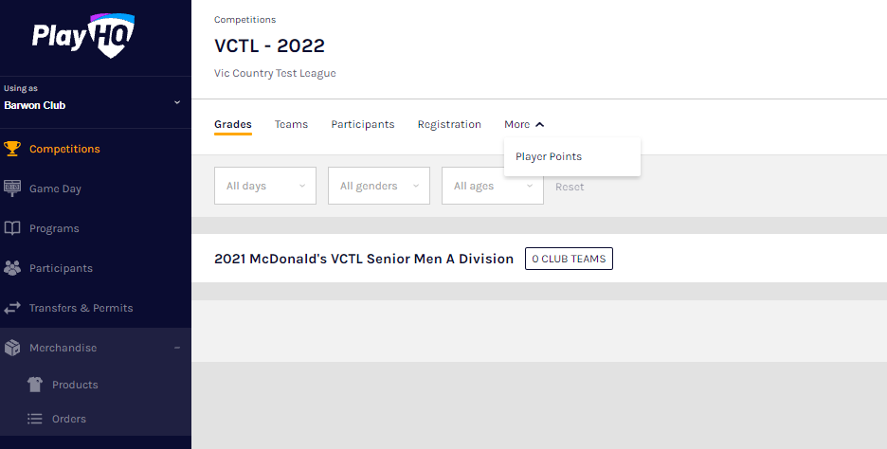
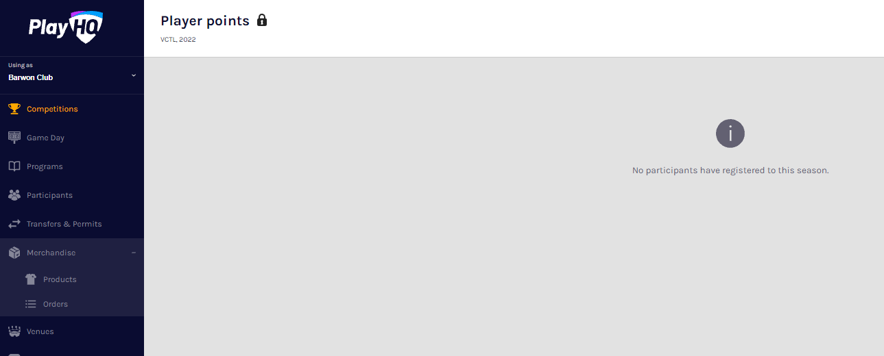
Player Points
If the Association has Player Points turned on for a Club, you can add Player Points to a Player or edit the Player Points for a Player.
In the left hand menu click on Competitions and click on the View button for the Competition. On the Grades page click on the More tab and select Player Points.
On the Player points page if the Association has not given the club access to add or edit Player Points the page will be locked and no additions or changes can be made.
On the Player points page if the Association has given the club access to add or edit Player Points, add the relevant number of player points for each player in the Player Points column and when completed click on the Update Changes button in the top right corner. Please note there are filter boxes above the list to assist with locating players if required.
Notes:
Competition in PlayHQ is an extra level within an Association which allows Association Admins to create more than one Competition in an Association i.e. Association Seniors & Association Juniors. Grade in PlayHQ formerly known as Competition in the GameDay (SportsTG) system.

Slide 28
Request a season permit
Please note club admins who have been given admin access will always have access to initiate a season permit request. This task can also be done by an association admin using as the club to provide assistance to Clubs if required.
In the left hand menu click on Transfer & Permits, select the Requests tab and click on the New Season Permit Request button.
On the New Season Permit Request page in the Competition section the Organisation, Competition and Season for the competition you require the player to permit to.
In the Season Permit Dates section add the From date and the To date. In the Player section you must select the player’s Club and Last Name and click on the Search button. You can add the First Name and Date of Birth to narrow down the search.
When you find the Player you wish to permit select them and click on the Review button in the top right corner.
If they are correct click on the Submit New Season Permit Request button in the top right corner.
On the Permit Request page you can view the Player details, the Request Details, the Season Permit Dates and the Status.
Notes:
Season Permit in PlayHQ formerly known as Type 2 Local Interchange Permit or Type 3 Temporary Transfer in the GameDay (SportsTG) system. All existing agreements have been pre loaded into PlayHQ.

Slide 29
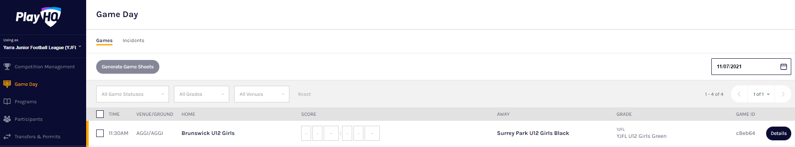
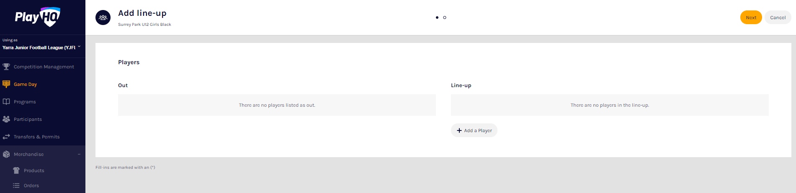
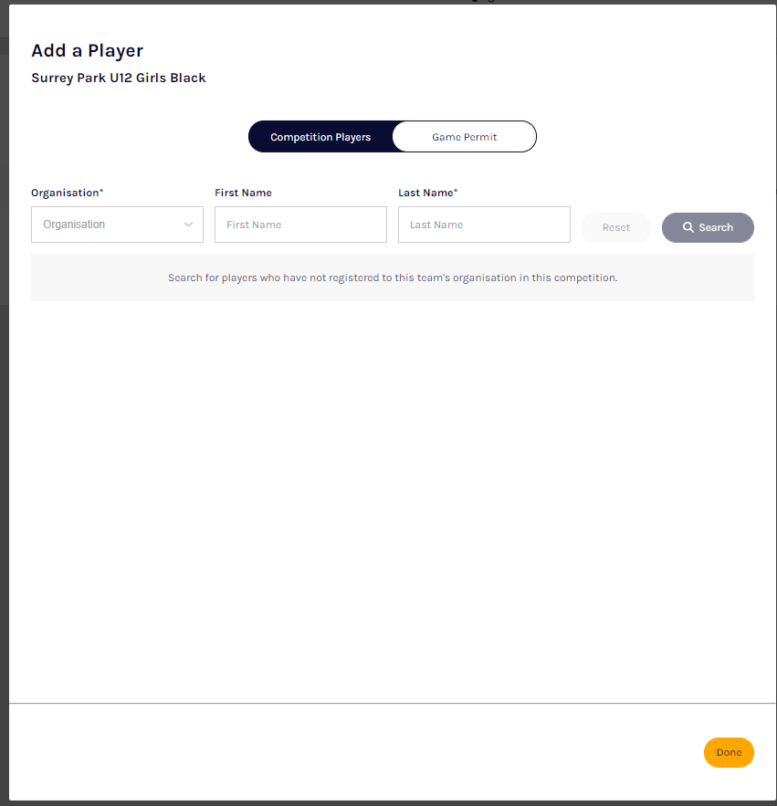
Game Day Permits
Game day permits are requested in the line up area
From the menu on the left-go to Game Day->pick the date in the right corner->click on details to open up.
Click on add player
You can choose from the list
or to add a player on a permit
Switch to Game permit
And follow the steps
Notes:
Gameday Permit in PlayHQ formerly known as Type 1 Match Day Permit in the GameDay (SportsTG) system. Line-up in PlayHQ formerly known as Selected Players in the GameDay (SportsTG) system. How to do the line up will be further explained later on.

Slide 30
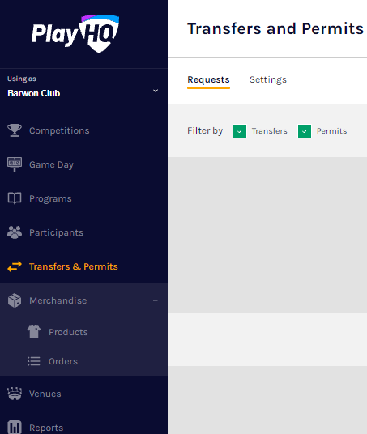
Transfers
When the Participant has completed the Participants Details page if a profile match is found and the Participant is trying to register to a different Club than the last Club they were registered with the Request a Transfer pop up box will appear, click on the Get Started button.
In the left hand menu click on Transfers and the full list of all Transfers will appear. To approve or decline a transfer click on the View button for the Transfer.
On the Transfer Request page you will be able to view: - whether the player is currently suspended & the player’s source club and source league
the player’s Profile information
the transfer Request Details
the Status of the transfer; and
the player’s Incident History
At the top of the page is Approve and Decline buttons.
If you click on the Decline button the Decline Transfer Request pop up will appear, select a Reason, add comments in the Details area if required and click on the Decline Transfer Request button.
Notes:
Transfers are initiated by the participant. When they have finalized the profile matching process and their account is set up when they register to a different club they were at in the last year they played the PlayHQ system will initiate a transfer process.

Slide 31
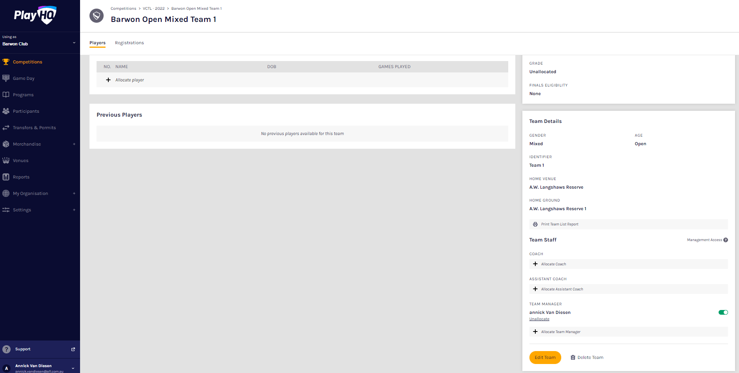
Team officials and managers - How to allocate & give access
In order for Coaches, Assistant Coaches & Team Managers to be selected in Team Lineup they need to be registered to be able to be allocated to the team.
In the left hand menu click on Competitions and click on the Competition. In the Teams tab click on the View button for the Team.
On the Team page under the Players tab scroll down to the Team Staff section. For the example below we going to allocate a Team Manager but same process can be followed to need to be registered to be able to Allocate a Coach or Assistant Coaches (and other officials in the future) to a Team. Click on Allocate Team Manager
The Allocate Team Manager pop up box will appear that will show a list of the Unallocated team managers. To Allocate Team Managers to the Team click the tick box for each Team Manager and click on the Allocate x Team Managers button.
At this point if you wish give Management Access to any of the Team Staff you can toggle the switch to on (green). This will enable those Team Staff to create & change line ups as well enter match results & add player statistics.
Notes:
Line-up in PlayHQ formerly known as Selected Players in the GameDay (SportsTG) system. Team managers and officials need to register in the PlayHQ participant portal. Once completed they will show up in the club participant list and they can then be allocated to a team/teams. They access the admin platform via the participant platform. (if they have been given admin access) Can be multiple teams. They do not have access to anything else for that club in the admin portal.

Slide 32
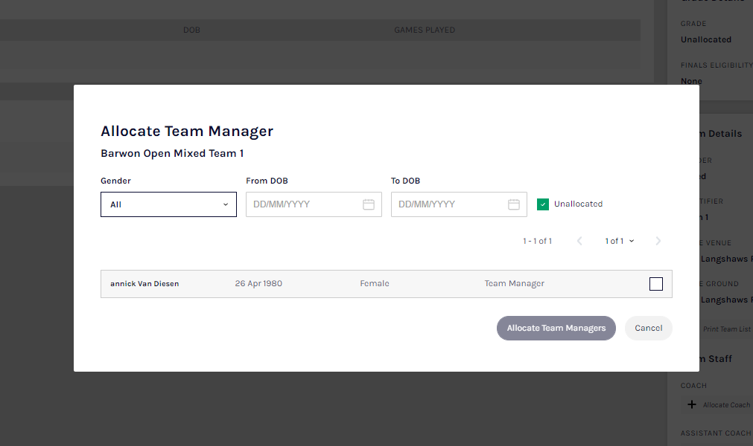
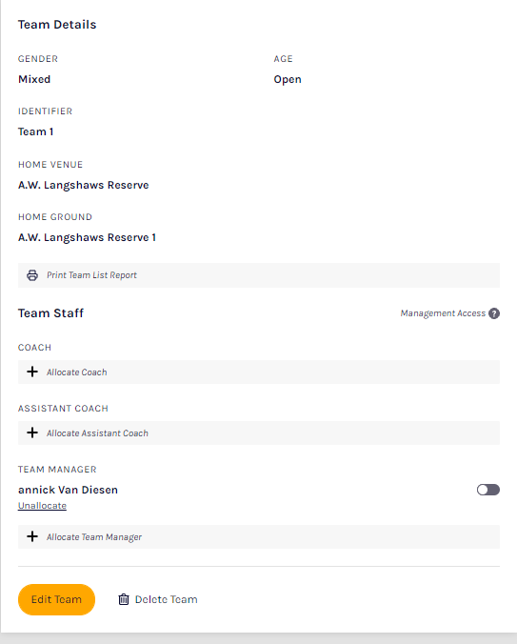
Team Managers
The Allocate Team Manager pop up box will appear that will show a list of the Unallocated team managers. To Allocate Team Managers to the Team click the tick box for each Team Manager and click on the Allocate x Team Managers button.
At this point if you wish give Management Access to any of the Team Staff you can toggle the switch to on (green). This will enable those Team Staff to create & change line ups as well enter match results & add player statistics.

Slide 33
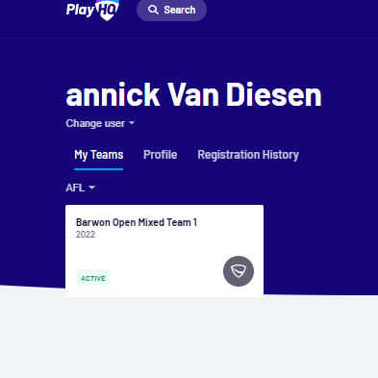
Team Managers
Team managers will then have access to the team admin via the participant portal and their profile will show the allocated teams.
They will be able to add/edit line up and team staff and coaches.
Add scores and statistics
In the squad area they can access player details such as emergency contacts.
Team manager name

Slide 34

Awards
Notes:
Unfortunately this feature is still under construction but it will be there for you to use at the start of the season and will be amazing. You will be provided with training and information once this is available.

Slide 35
Live Scoring & E-Scoring
To login and access Electronic Scoring go to https://afl.score.playhq.com/auth/login and enter the username & password you have registered.
You will land on the New Scoring Session page.
Click on +the icon to select the Venue for the match you wish to score is being played. Start typing the name of the Venue in the search bar and click on the + icon when the venue appears.
You will be returned to the New Scoring Session page. Click on the + icon to select the Day for the match you wish to score is being played.
Select the Day of the match and click on the Add button.
You will be returned to the New Scoring Session page. Click on the + icon to create a PIN for the session.
Add a New PIN in the area provided, add Confirm PIN in the area provided and click on the Add button.
You will be returned to the New Scoring Session page. Click on the Start Session button.
You will be taken to the Home page which will shows matches at Venue for that day.
Click on the Match and you will taken to the Electronic Scoring page. The Teams will show with the Players that have been selected in the Line-up.
To make changes click on the Edit button below the Line-up list.
Notes:
Very important to remember the PIN as that is used to finalize the match.

Slide 36
Start electronic scoring
To start Electronic Scoring click on the Start button in the top right corner and name of button will change to Pause. If the match is being played with time on to stop the clock click on the Pause button. If the clock has began counting and you need to make a change click on the pencil icon and edit page will pop up for you to make changes.
To add actions to a Player click on the Player and then click on 6 for a goal or click on 1 for a behind or click on CARD then select Yellow or Red – the process can also be done the opposite way i.e. click the action and then click the Player. This will add the actions to the Players and if it a score it will be added to the Team total. If you make an error with either a Team or a Player action click on the icon and it will be removed.
To end the quarter click on the icon in the top left corner and select End Period. To start the next quarter click on the Start button in the top right corner.
To end the match first you need to end the final quarter, then click on the icon and select End Game and the Confirm Result page will pop up.
Click on Submit in the top right corner and the PIN pop up box will appear.

Slide 37
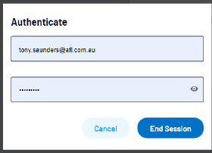
Ending the session
Add the PIN you created and click on the Confirm button, you will be returned to the Home page which will show the Match in the Completed tab.
Before closing the page click on the End Session button in the top left corner and the End Session pop up will appear.
Click on the End Session button and the Authenticate pop up will appear

Slide 38
Season Set Up Checklist
Season Setup Checklist
o My Organisation -> Admins - update (5 minutes)
o My Organisation -> Overview -> Details - update (10 minutes)
o My Organisation -> Overview -> Contacts - update (10 minutes)
o My Organisation -> Overview -> Payments - update (10 minutes)
o Settings -> General -> Government Vouchers - setup (1 minute)
o Settings -> General -> Integrations - setup Mailchimp (15 minutes)
o Transfers -> Settings - add notification emails & update auto approval (2 minutes)
o Merchandise -> Products – add products (If required) (15 minutes)
o Competitions -> My Competitions -> Registration -> Custom Fields - add (if required) (5 minutes) o Competitions -> My Competitions -> Registration -> Forms – configure Participant to Club form (15 minutes)

Slide 39
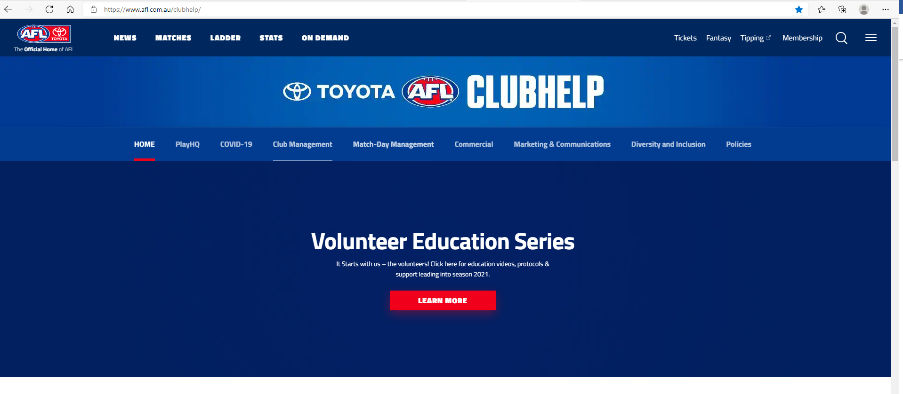
More Information and Support
For support please contact your Super User.
Please use the COMMUNITY-CLUB-USER-GUIDE.pdf (afl.com.au)
AFL Club help website.
Please use the COMMUNITY-CLUB-USER-GUIDE.pdf (afl.com.au)
AFL Customer Service Team
Our friendly staff are always here to assist all questions relating to Community Football. Please contact our Customer Service staff on 1800 PLAYAFL or clubhelp@afl.com.au who will be able to assist and make your valuable role that much easier. The team are there to help your association admins, club admins and participants as well, so for any questions that they may have on their registration or Community Football leave it to our Customer Service team.

Slide 40
Questions & Feedback
Name & Club | Question/Feedback

Slide 41


